Slide 1
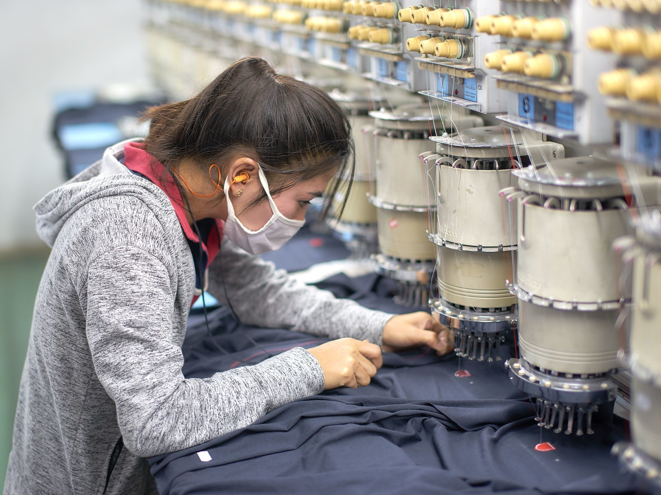
Weaving Insights: Understanding Garment Employee Productivity
Group 2
Christina Thy Nguyen
Mira Radhakrishnan
Pallavi Arora
Sindhuri Reddy
Suma Nednurkar
Notes:
Today, we delve into the intricate fabric of the garment industry, unraveling the threads that connect employee efficiency to the overall tapestry of production.

Slide 2
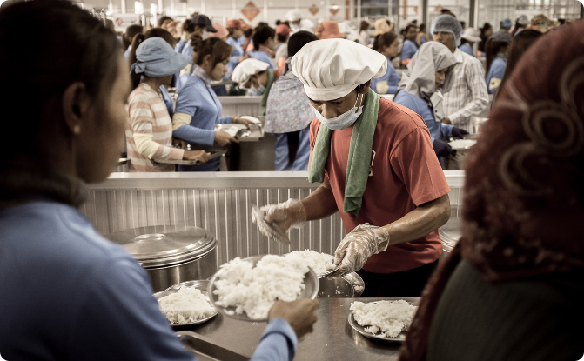
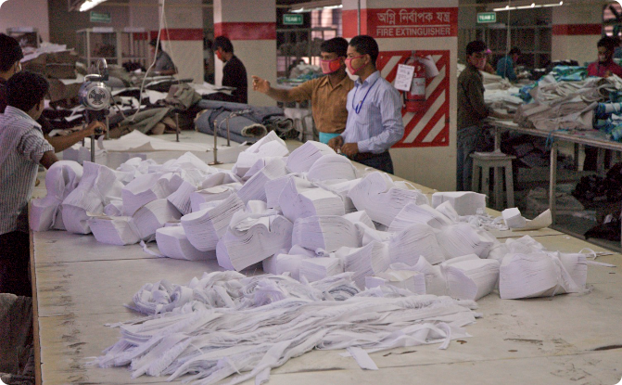
The Industry
Global Importance
Labor Dynamics
The garment industry is one of the largest sources of employment and revenue in developing countries.
Labor Intensive Industries are often characterized by low-wages and long working hours.
Notes:
The Garment Industry exemplifies modern industrial globalization, relying on labor-intensive, manual processes. Meeting global garment demand hinges on the performance of manufacturing employees. Decision-makers in the industry prioritize tracking, analyzing, and predicting team productivity for effective management.

Slide 3

Objective :
Understand factors that affect productivity and employee performance, and identify areas for improvement
Key hypothesis :
Explore the relationship between incentives, allocated task time, team size, and productivity.
Target Audience:
Manager/Executive of the garment company, Other garment manufacturing companies

Slide 4
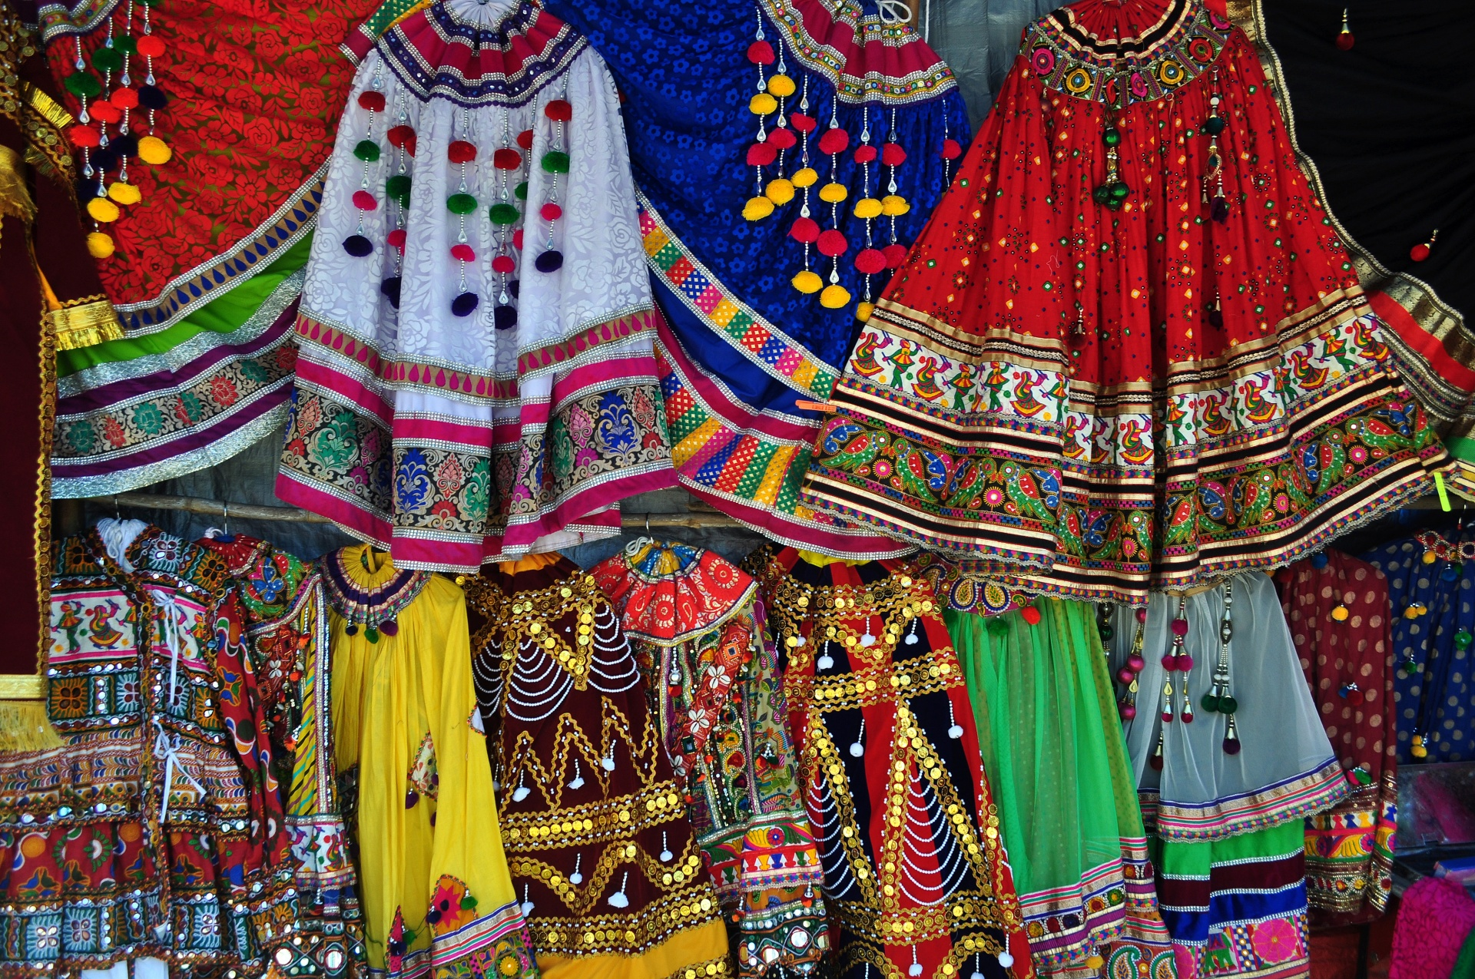
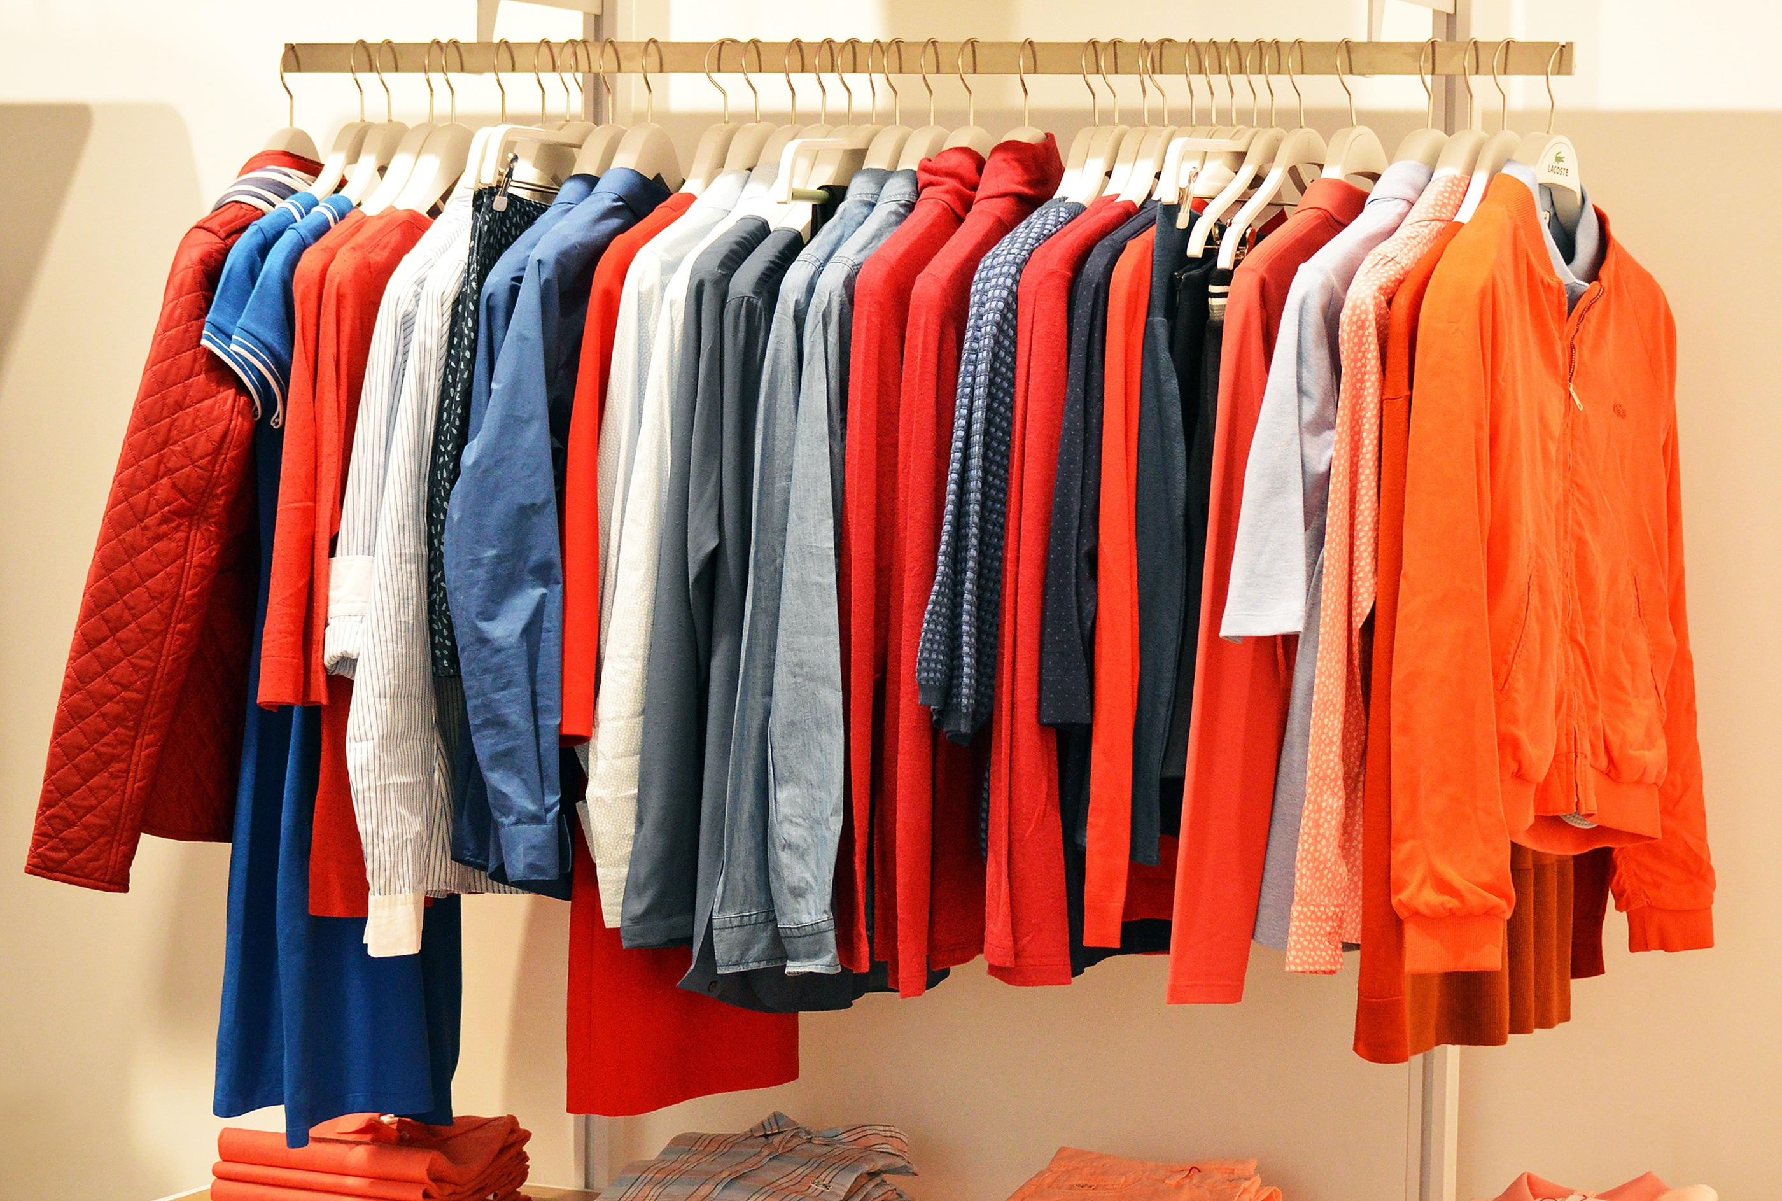
Data
https://archive.ics.uci.edu/dataset/597/productivity+prediction+of+garment+employees
Data Period: December 2014 – October 2015
Productivity = The proportion of targeted number of products completed in a day
Does changing time allocation for the task affect productivity?
Does the number of workers per team have a greater effect on productivity? Financial incentives?
Total of 15 variables
Notes:
Sindhuri
This dataset was obtained from the UCI repository, with a total of 15 features of variables.
The target variable that we are trying to predict is the Productivity of the factory workers. We are trying to weigh which variable has the most significant impact on productivity performance.
Within this dataset there are different departments, and different teams.
Each month is divided into separate quarters

Slide 5
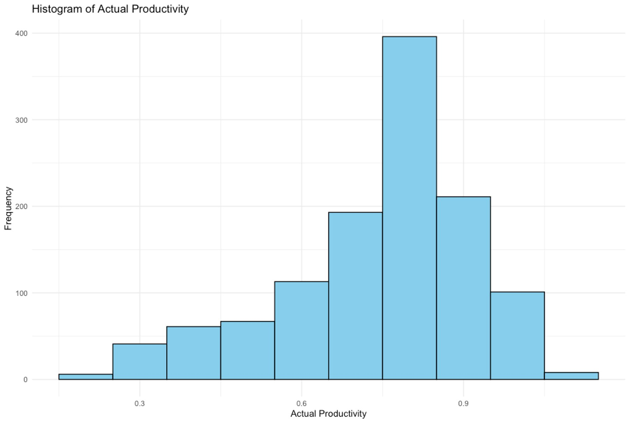
Exploratory Data Analysis (EDA)
 | Productivity
Minimum | 0.23
Maximum | 1.12
Average | 0.74

Slide 6
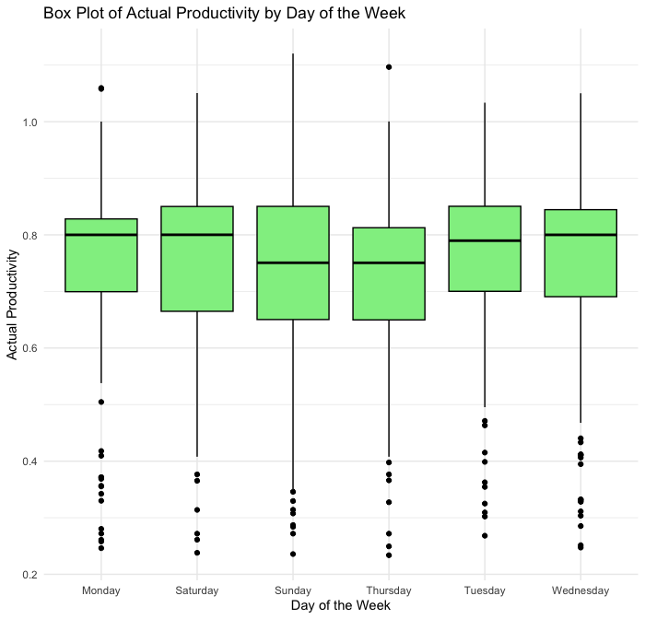

Slide 7
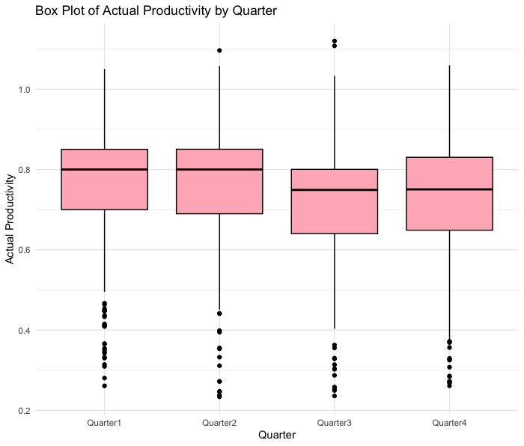

Slide 8
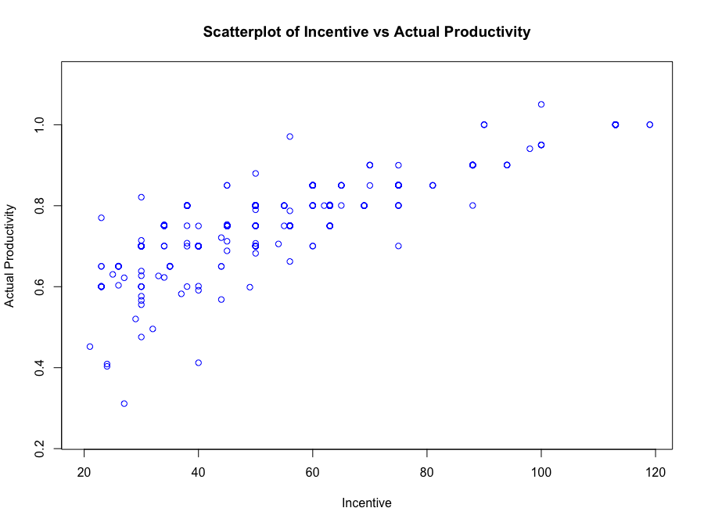
 | Incentive
Minimum | 0 BDT
Maximum | 119 BDT
Average | 26.16 BDT
Notes:
When given, incentives started at 20 BDT and were upwards to around 119 BDT

Slide 9

Model
Linear regression was used to find patterns
Key variables:
Incentive in Bangladeshi taka (BDT)
Allocated minutes for a task
Number of workers on a team
Length of work interruptions
Quarter of each month
Notes:
Christina
We used a linear regression model to find patterns and trends in our data.
They key variables that were included were incentives in BDT, quarter of each month, allocated minutes for a task, number of workers on a team, and length of work interruptions.
We used a stepwise backwards regression to find that these variables best predicted productivity.

Slide 10

Results
Key Model Predictions:
Productivity Projection: The model forecasts a productivity rate of around 60.06%.
Time Allocation Impact: A minute reduction in task time correlates with an approximate 0.41% decrease in productivity.
Incentive Influence: A 10 BDT incentive increase is associated with an estimated 2.95% productivity boost.
Workforce Addition: Each additional worker contributes to an anticipated 0.32% increase in productivity.
Notes:
Suma
100 BDT = $1 USD
Monthly minimum wage = $80 USD or 8800 BDT

Slide 11

Impacts
Why does it matter?
This model serves as a valuable tool for managers, enabling effective resource allocation. For example, the insight that a 10 BDT incentive hike corresponds to a 2.95% productivity increase informs decisions on incentive distribution for optimal performance.
Notes:
Manager/executives should focus on the structure of the teams in order to maximize productivity.

Slide 12

References
Hasnat, S. (2023, November 8). Workers making clothes for top brands reject a proposal: $113 A month. The New York Times. https://www.nytimes.com/2023/11/08/world/asia/bangladesh-minimum-wage-protests.html
Productivity Prediction of Garment Employees. (2020). UCI Machine Learning Repository. https://doi.org/10.24432/C51S6D.

